Slide 1
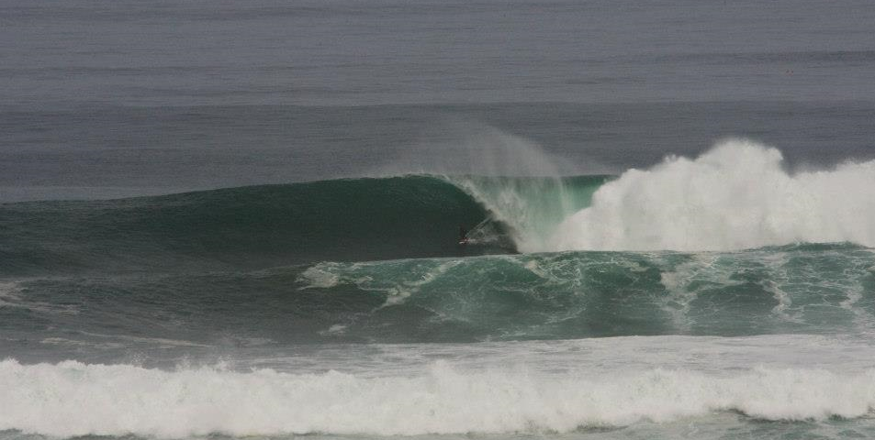
Identifying Regionally significant surf breaks

Slide 2
Workshop Overview
Introductions
Overview
National legislation
What are other regions doing?
What are we proposing?
Identifying breaks
Top 20
Criteria
Rate surf breaks
Policy
Notes:
Round the table for introductions
NZCPS
What is it – National planning document- put out by DOC – All councils must give effect to it.
Discussion on policy 16

Slide 3
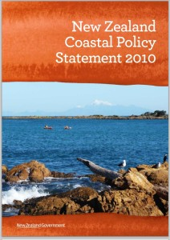
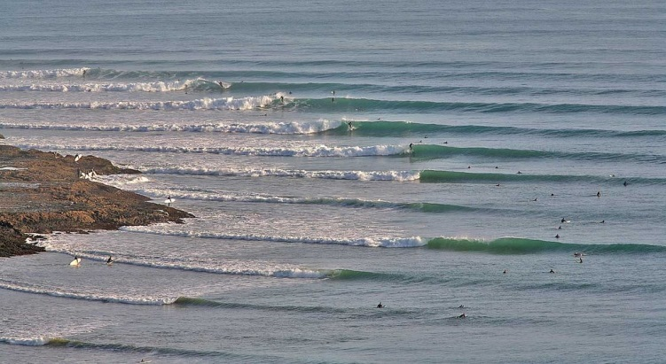
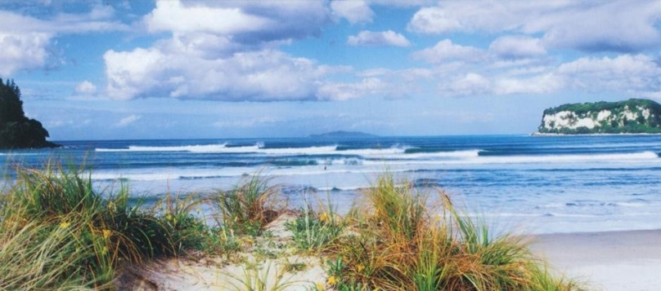
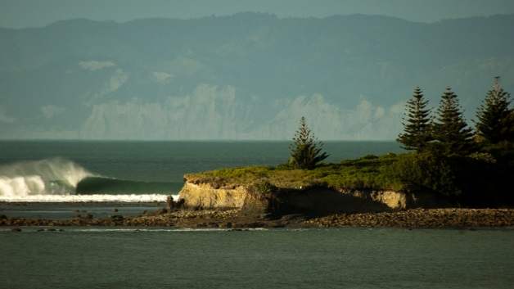
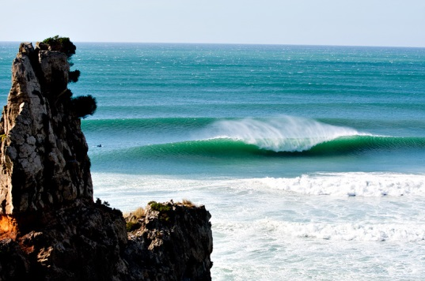
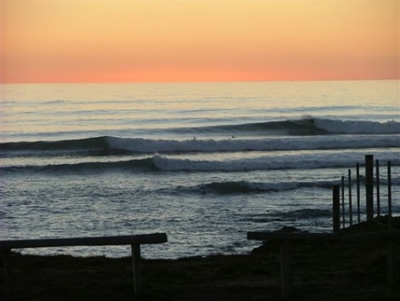
Nationally Significant Surf breaks

Slide 4
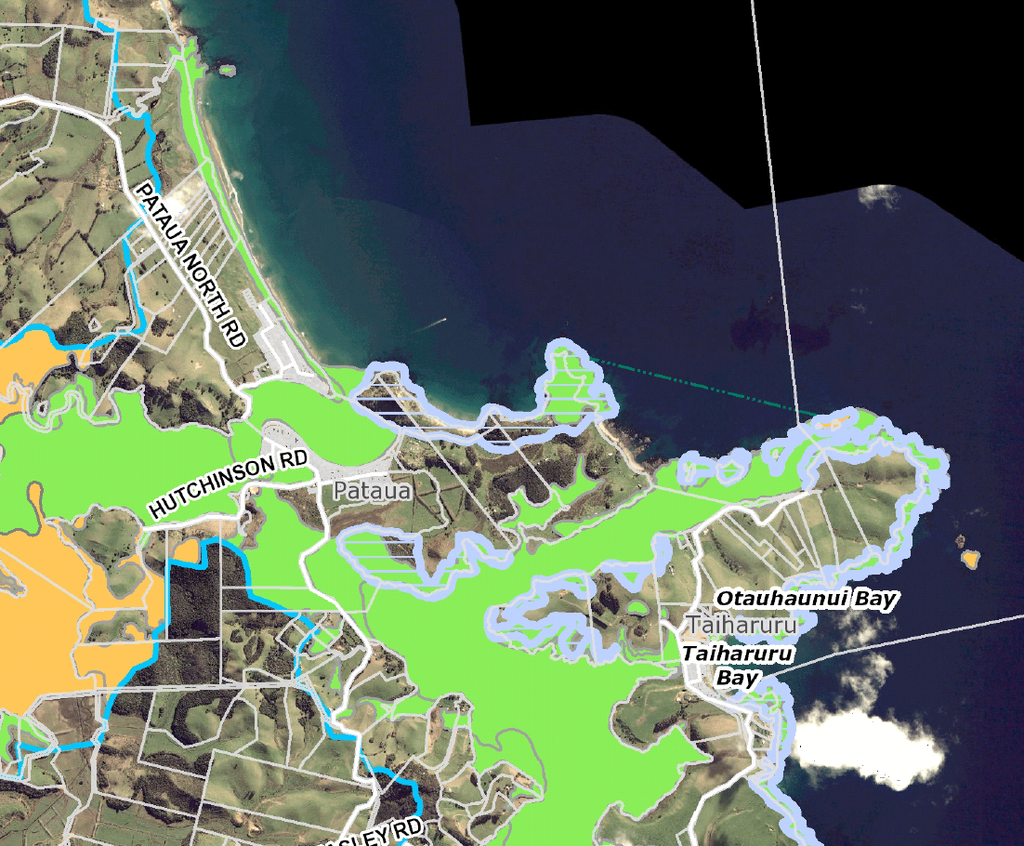

Slide 5
Slide Heading 1
What are we doing?
Mapping regionally significant breaks
Policy directing management of significant breaks (not yet identified)
Regional Plan – ‘rule’ book for natural resources
Draft mid 2016
Notified mid 2017

Slide 6
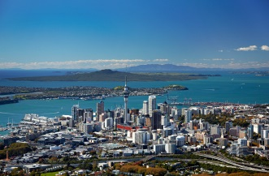
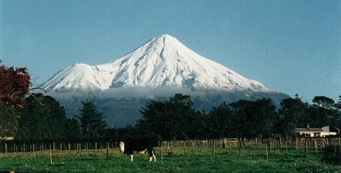
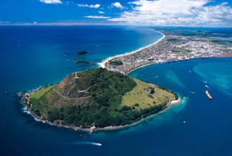
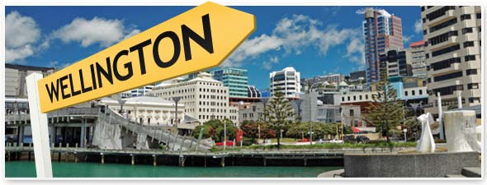
What are others doing?
Mapped using polygons , Policy –avoid or remedy / mitigate adverse effects
Mapped in Regional Policy Statement, Policy –avoid remedy mitigate adverse effects on amenity values
Mapped using symbols, Policy –avoid significant adverse effects, 1km trigger
Mapped using polygons , Policy –avoid significant effects on breaks, avoid minor effects on natural processes and avoid ongoing effects on access.

Slide 7
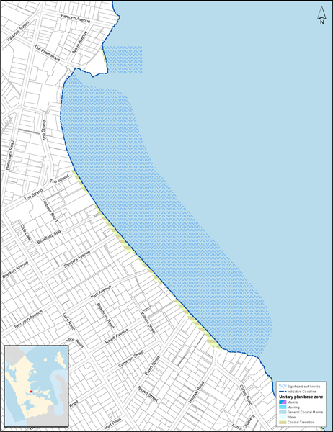
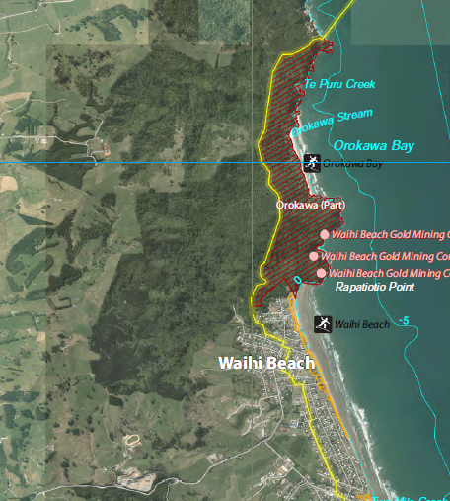
Slide Heading 1
Other regions
Auckland
Bay of plenty

Slide 8
Slide Heading 1
Plan for today
Goal = identify a top 12-15
Start with 20+
Confirm criteria
Assess the 20+ against the criteria
Identify 12-15

Slide 9
Top 20 surf breaks
Michael’s Top 20
Mangawhai Bar The racecourse (Ruakaka) Ocean Beach Pataua Bar Horahora Bar Ngunguru Bar Sandy Bay Whananaki Bar Pareparea Beach Elliots Bay | Tapuatahi Reefs Takou Bay Taupo Bay (beach and point) Henderson Bay Rarawa Beach The bluff Blue House Waimamaku Beach Kawarua and Waipoa reefs Baylys Beach

Slide 10
Slide Heading 1
Proposed criteria
Wave quality
Consistency
Rarity (of break type)
Uniqueness
Frequency of use / popularity
Wilderness / isolation

Slide 11
Scoring
10 = The best example in the region
1 = A very poor example e.g. inner harbour beach
Break Name | Wave Quality | Consistency | Rarity (of break type) | Uniqueness | Popularity | Wilderness / Isolation | TOTAL Score
Mangawhai Bar
Mangawhai Beach
Ocean beach | 7 | 7 | 3 | 3 | 7 | 4

Slide 12
Michael Payne
Policy Analyst
09 470 1121
michaelpa@nrc.govt.nz
www.nrc.govt.nz

